Slide 1
Weather Data API

Slide 2
High level Overview
APIs 1. Get current Weather data by coordinates (lat and lon)
2. Get current average temperature for multiple coordinates
3. Get a list of high temperature across the globe at a particular time

Slide 3
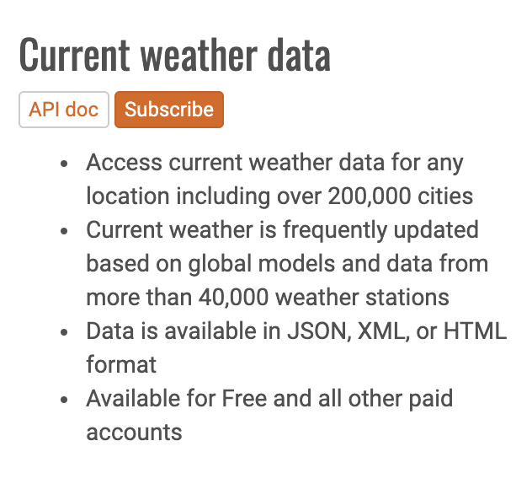

3rd Party API
I used a 3rd party API (OpenWeatherMap.com) to get live weather data

Slide 4


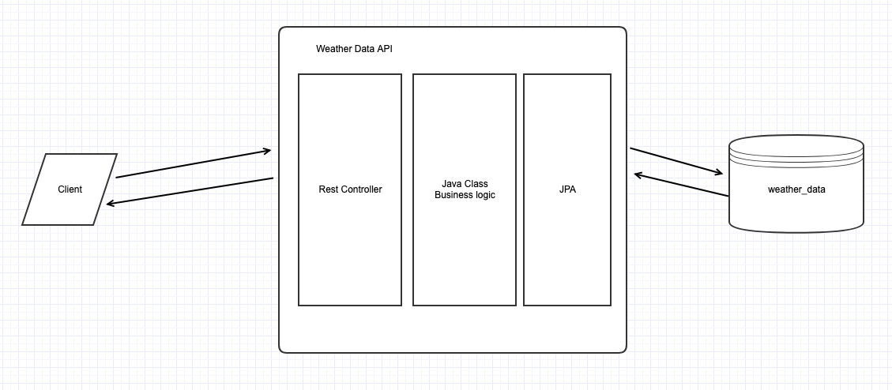
High level Overview

Slide 5
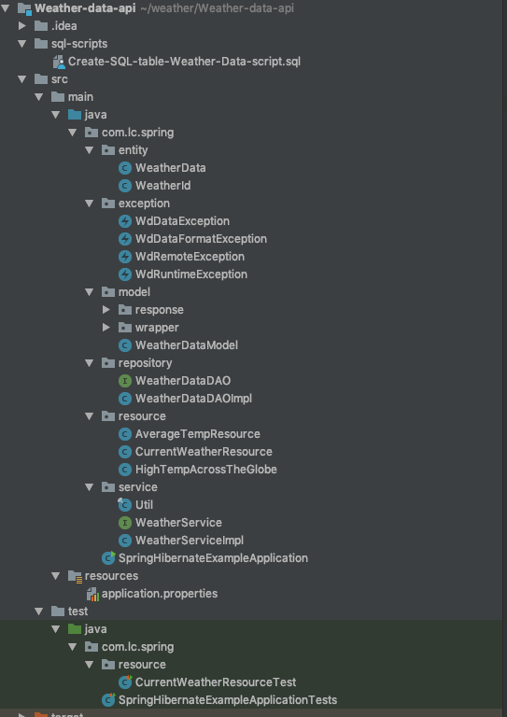
High level Overview

Slide 6
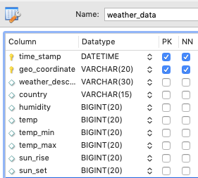
Table Schema
1. Composite Primary Key: time_stamp + geo_coordinate
2. Indexing to speed up querying Indexing time_stamp and geo_coordinate

Slide 7

Uber H3 open source
Latitude, longitude -> geo_coordinate
40.689167, -74.044444 -> 8a2a1072b59ffff
8a2a1072b59ffff ->40.689167, -74.044444
Advantage: Simplify and speed up querying

Slide 8
1. Get current Weather data by coordinates (lat and lon)
Procedures: Client Call -> Calling external API (Get live data) -> Write into Mysql database -> Query database -> Return result to Client
http://localhost:9000/api/weather/37.7749/coordinates/-122.4194/current
Simulation: We simulate live data being written into the data by calling the external API and write the result into the DB

Slide 9
2. Get current average temperature for multiple coordinates
Procedures: Client Call -> Calling external API (Get live data) -> Write into Mysql database sequentially -> Uses multithreading query database concurrently -> calculate the average temp -> Return result to Client
Simulation: We simulate live data being written into the data by calling the external API and write the results into the DB

Slide 10
3. Get a list of high temperature across the globe at a particular time
Procedures: Client Call -> Query database for all weather Data in that time-> Uses multithreading to process data concurrently -> Return result to Client Temp threshold: 281 Kelvin (46.13F)
http://localhost:9000/api/weather/time/2019-04-04 12:38:10

Slide 11
Reference:
Github Repo: https://github.com/youaregreathk/Weather-data-api
Uber H3 geo_coordinates: https://github.com/uber/h3 Lombok: https://projectlombok.org/

Slide 12

Questions

